Slide 1

Shree Parida
Kevin Mark
Chris Mixa
Hayden Schennum
Puii Jaiwijitr
2023-11-18
SPARKS

Slide 2






Let’s talk about dating apps
Notes:
Let’s talk about apps we currently have
So who has used these dating apps on our screen?
And which app has helped you to find your current girlfriend/boyfriend
My next question is kinda an important one – How many people struggle with kickstarting that initial conversation
What happens when we swipe right a person and we don’t know what to say?
Well there comes our app called Sparks.

Slide 3

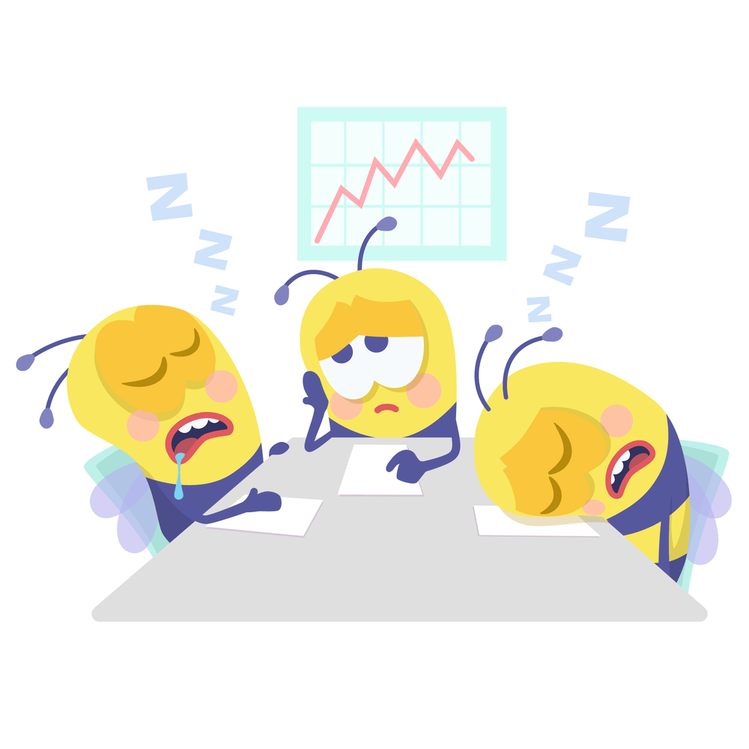




Problem statement
Boring conversations
Overthinking
Cold feet
Running out of
plan ideas
Logistics
Sense of desperation
Notes:
Cold feet
Basic & Boring conversations
Overthinking
Running out of date plan ideas
Logistics
Sense of desperation

Slide 4
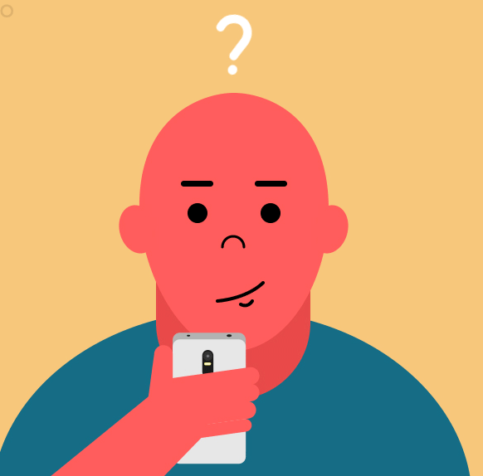

Why use our app?
To Initiate
Conversations
Date

Slide 5

Personas
Harry Potter
25 yrs old
Scotland
Notes:
Meet Tom
He is 25 yrs old and in search for a relationship. He has used multiple apps before but nothing has worked out.
So Sparks is going to help find Tom a match!

Slide 6
Unique features
Compulsory icebreaker - Games to get to know the other person
Assistance to initiate and plan a date – prompts to motivate to plan the date based on location, preferences
Notes:
Compulsory icebreaker
Assistance to initiate and plan a date.

Slide 7

Let’s demo it!

Slide 8
Next Steps…
Monetization – gather points to use more premium functionalities
Community set-ups like speed dating in person
The prompts can be more AI influenced on the basis of individual profiles
Notes:
What future developments
Monetization
There are people who are more comfortable in group settings. The app can organize a group gathering or

Slide 9
Thank you!!!
Notes:
What future
Monetization

